Slide 1
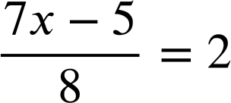

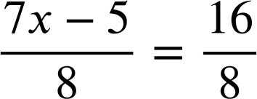
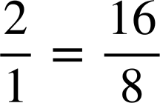
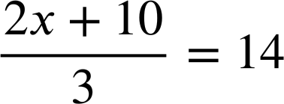
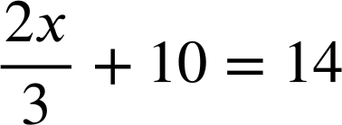
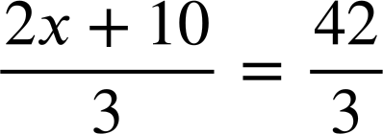
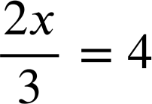
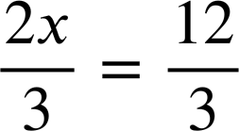
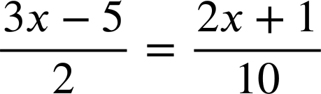
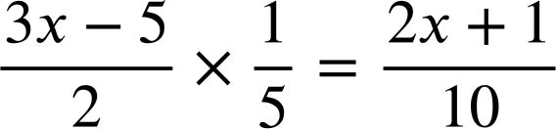
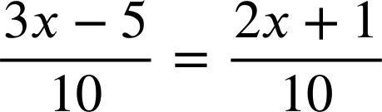
Solving complex linear equations
Task A: Introduction to complex linear equations
1) Alex solved this complex linear equation. Fill in the missing blanks in his work.
7x − 5 | = | 16
7x | = | 21
x | = | 3
2) Solve:
a)
b)
2x + 10 | = | 42
2x | = | 32
x | = | 16
2x | = | 12
x | = | 6
Task B: Solving complex linear equations
1) Where is the error in this attempted solution?
Find the error and write a sentence explaining why it is wrong.
Multiplying the LHS by a fifth and not doing the same to the RHS means our equation has lost equality at this point.
3x − 5 = 2x + 1
x − 5 = 1
x = 6

Slide 2

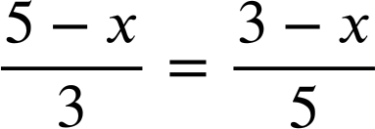
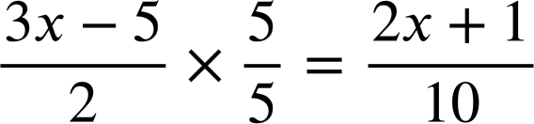
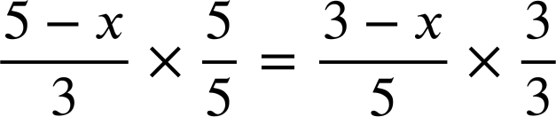
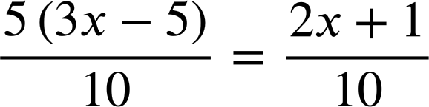
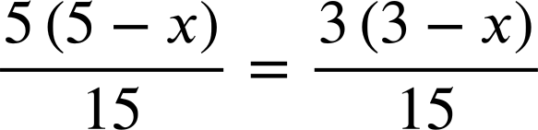
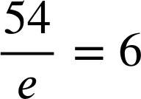
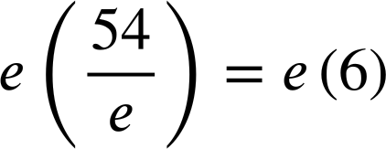
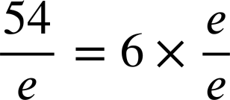
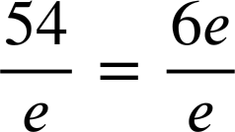
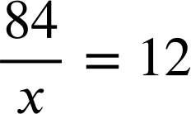
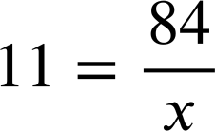
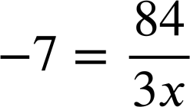
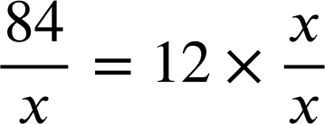
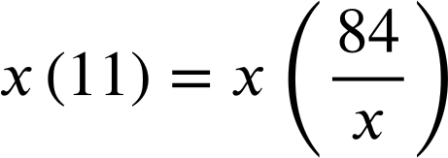
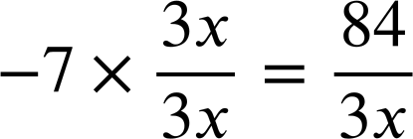
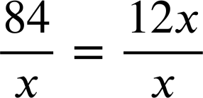
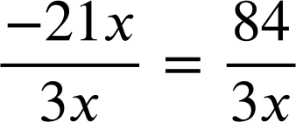
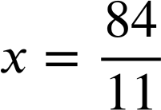
Solving complex linear equations
2) Aisha successfully solved two equations. Fill in the missing blanks in her working.
5(3x − 5) = 2x + 1
5(5 − x) = 3(3 − x)
15x − 25 = 2x + 1
25 − 5x = 9 − 3x
13x = 26
16 = 2x
x = 2
x = 8
Task C: Solving simple rational equations
1) Finish each method to solve this equation in two different ways:
54 = 6e
e = 9
54 = 6e
e = 9
2) Solve:
a)
b)
c)
11x = 84
84 = 12x
−21x = 84
x = 7
x = −4
Mathematics in Education and Industry.
v2.3

